Slide 1
מצגת עבודה מסכמת תיאוריה סטטיסטית
שילה אביטל ושראיל ליברמן

Slide 2
Student Alcohol Consumption (cheers!)

Slide 3

The DATA
The dataset we chose quantifies alcohol consumption levels among two groups of students (math and Portuguese) during weekdays and weekends.
The dataset classifies the students according to their age, parents’ details, romantic relationship, and more.

Slide 4

The Question
We wanted to check whether there was any sub-group of the students which is more inclined to drink more during the weekends.
The sub-groups we chose are single (S) compared to dating students (D) and students that their parents live apart from each other (PLA) compared to students that their parents live together (PLT).
We anticipated that the S and PLA groups will be more inclined to drink more during the weekends.

Slide 5

The Method
We used the U-test non-parametric exam to see whether the distribution of the different groups indicate a change in the alcohol consumption in the groups.
We displayed the data as a histogram of the alcohol consumption levels (from 1 to 5) across each group.
We used a separate test for each of the questions.

Slide 6
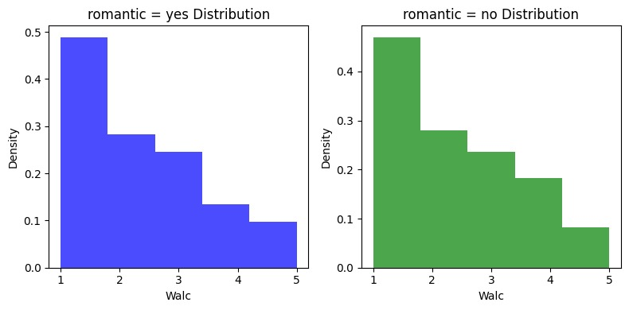

The Results – Part 1
We first compared group S to group D. The results were inconclusive for $α=0.05$ (the p-value is 0.73).
So even though the average drinking score for the single students was higher, the distributions were too similar to make a definite statement.

Slide 7
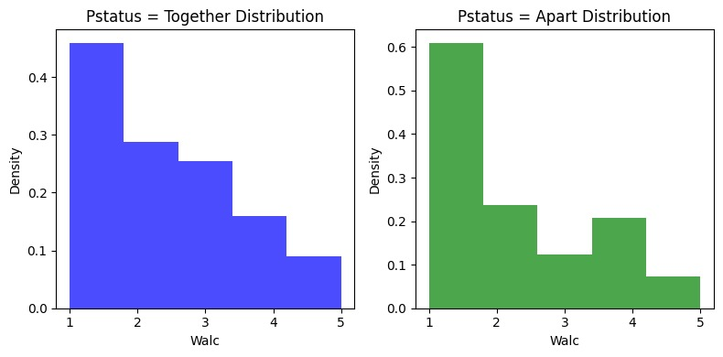

The Results – Part 2
We then compared group PLA to group PLT. The results were surprising. They were exactly opposite to our assumption!
The data clearly indicates that the students that their parents live apart tend to drink more than students that their parents live together.
We again used $α=0.05.$ The p-value we received was 0.029.

Slide 8
Thank
You!

